Slide 1
NEW EXHIBITION
A competition was launched to create a new medal
which represents
the city of Le Vésinet or « Le Cèdre » school.
Here is the exhibition of the different creations and articles which present the artists’ intentions.
We wish you a great visit!

Slide 2
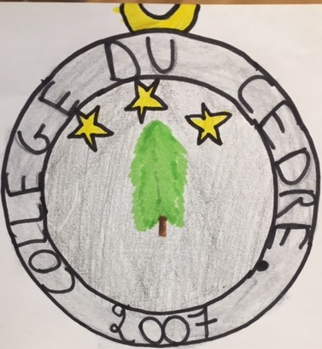
The « collège du cèdre » is a famous public school, it is located in France in Le Vésinet.
This medal was created in 2007. The medal is to encourage students who didn’t succeed in their « brevet » graduation. Because they need to believe in their talent. It is to give them courage.
The creator of this famous medal is Locarie De la Ferronière. She was born in 1992, today she is 28 years old.
On the heads of this medal we can see two symbols: the first one is a cedar tree, it represents the school ( “cèdre” means cedar). This cedar it is not similar to others. It has been the one in the middle of our school for a long time. The second symbol is stars in the sky. They are the representation of our goal.
The date of the creation is written and the name of the school as well as the name of the creator.
By Anaïs 5e2

Slide 3
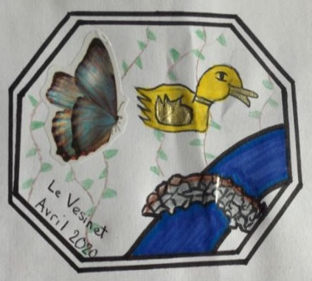
This medal was created for the people who
Live in Le Vésinet.
It features three emblems to represent the nature and animals found around the lakes.
Le Vésinet has many lakes: « Lac des Ibis »,
« Lac Inférieur », … where we can see lots of animals such as ducks and butterflies (as on
this medal) but also squirrels, geese, snails…
This medal is for all the people who settle in
Le Vésinet with their family. This is a gift from
the city to thank them for choosing this town.
By Anna 5e3

Slide 4
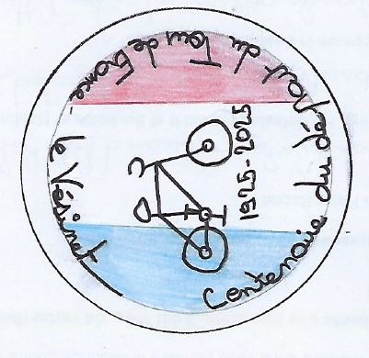
This medal shows a bicycle to commemorate the centenary of the departure of the « Tour de France » from Le Vésinet in 1925. This medal is given to sportsmen when winning a competition.
By Antoine 5e1

Slide 5
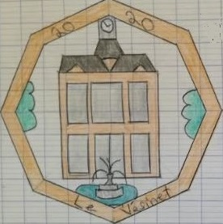
Here is the new medal of Le Vésinet which is intended for the inhabitants of the city. In the middle it represents the town hall of Le Vésinet. We changed the medal because the other one was too old.
Arnaud 5e2

Slide 6
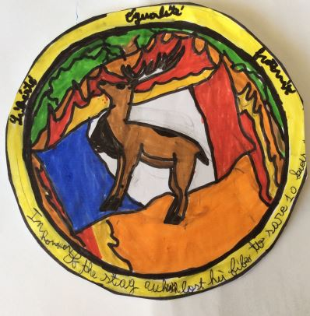
Hello I’m Benjamin B. a reporter from the Newspapers
“Le Vésinet”. Today’s article will be about the new medal of Le Vésinet. The new medal has a stag on it as you can see. There is also the flag of our country. Behind the stag there are flames and trees, if you really have good eyes you can see that it is written "In honour of the stag which lost his life to save ten kids”. I will tell you the story of our new medal. It was on February 15th, the fire started when somebody threw a cigarette in the forest, but in the forest there were 10 kids playing football . The fire spread rapidly and became a blaze . The stag which felt the danger ran to escape the fire . But when it heard the kids crying , it chose to save their lives instead of its. The stag took the 10 kids on his back and ran as fast as it could and saved the 10 kids. Sadly, the stag died because it had lots of burn marks and also from asphyxiation. This is why we dedicated this medal to our hero, the stag .
By Benjamin 5e2

Slide 7
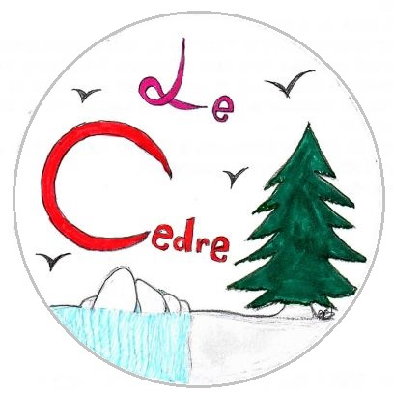
This medal represents « Le Cèdre» school which is a public secondary school. This medal is intended for the people who work in this place (the principal, the assistant principal, the chief education advisor, the supervisor, the teachers, the nurse, the cook, the cleaning staff, the students). On this medal we can find a tree and also the name of the school.
By Eloise 5e3

Slide 8
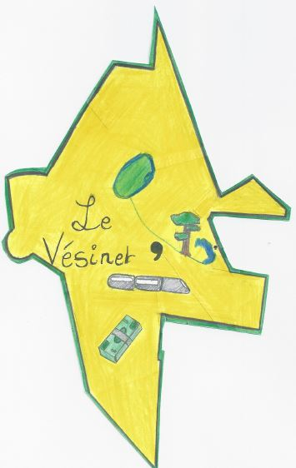
This is the new medal of Le Vésinet. It was created by Emile D. on 21st April 2020, for the championship of the medal 2020 organized in Le Vésinet, France. It is addressed to all citizens from Le Vésinet . The medal has the shape of the city. It is yellow inside because it is a golden medal and it is green on the outside because Le Vésinet is a city with a lot of parks. On the right of the medal you can see a lake, it is « Lac Supérieur » and next to the lake you can see a cedar tree for the school, « Collège le Cèdre ». The point next to the lake shows where the author lives. Under the tree there is a train for the train station. Next to the tree there is a coma for the shop « Monoprix » (the coma is the logo of the shop). Under the train there are notes because Le Vésinet is a rich city. There is a park called « Parc des Ibis »: it is the blue and green shape on top.
By Emile 5e1

Slide 9
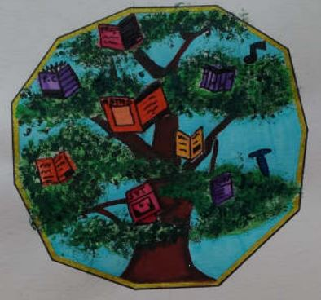
I designed a new medal for « Le Cèdre » secondary school. In this medal there is the emblem of the school: a cedar tree. In this cedar tree there are school books that we need to study. This medal has eleven sides. They represent the eleven subjects which are taught at school. This creation is made for academic success. The pupil who will have the best marks for their school final graduation, will get the medal. At the end of the school year, there is a party with all pupils, and the principal will give the medal to the best pupil of the year.
By Emma 5e1

Slide 10
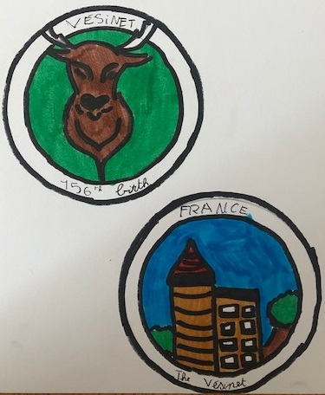
The designer of this medal, Esteban L., chose a classical round shape. It was created to replace the old medal which was not beautiful and was 73 years old.
The medal features the iconic stag and the house of Josephine Baker.
The medal commemorates the 136th anniversary of the stag.
By Esteban 5e 1

Slide 11
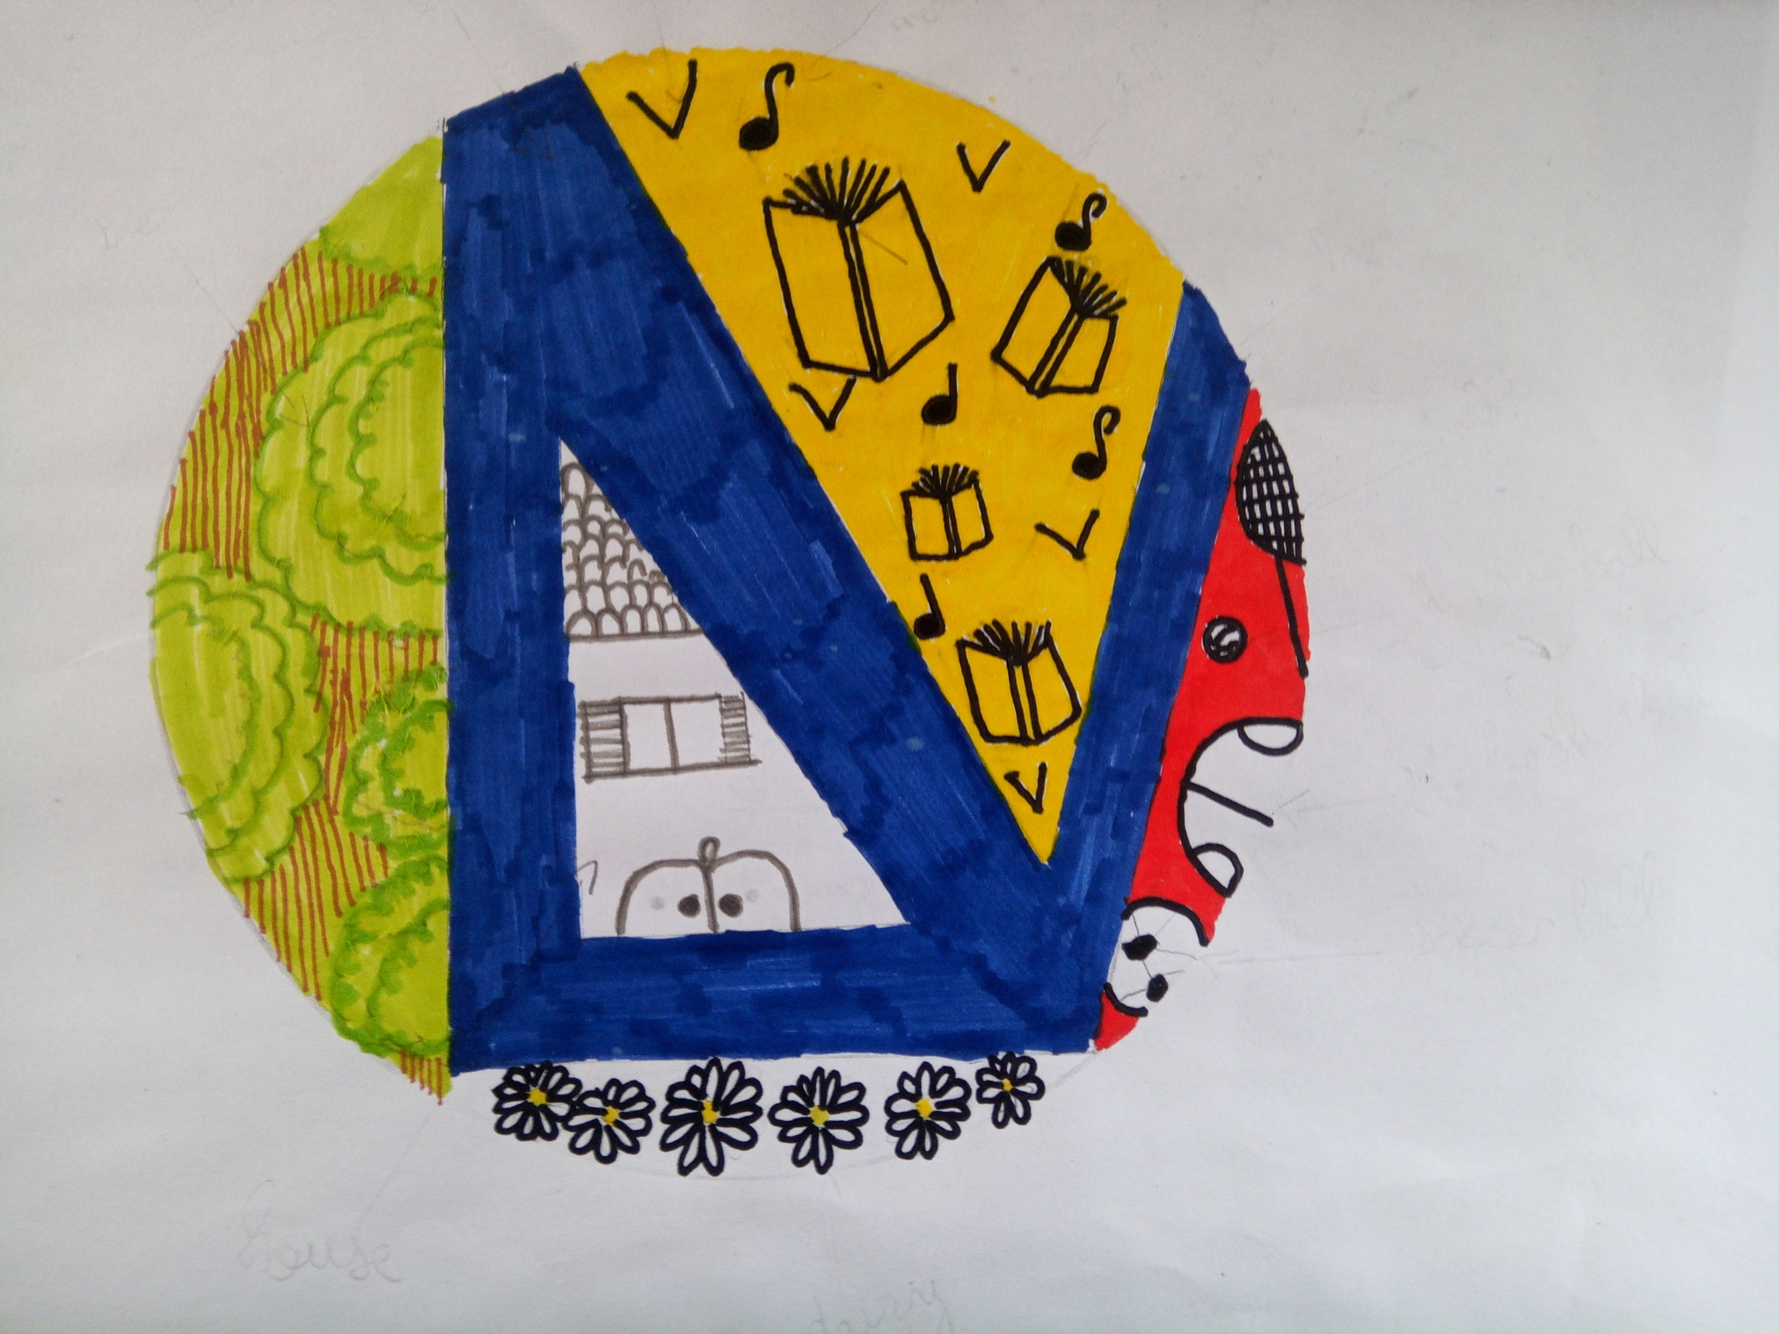
Following the local elections, the new mayor decided to make a new medal that would represent Le Vésinet : more dynamic, more modern, and younger. The choice was made to put more colours and more decorations on the medal.
Blue represents the water for the canals.
Green is the colour of nature for the parks.
Yellow for knowledge like the lights.
Red for sport.
Daisies, symbols of the past because of Alphonse Pallu, creator of Le Vésinet city, who called one of his two daughters Marguerite.
I drew a house because Le Vésinet was one of the first residential areas created in the suburbs of Paris at the end of the 19th century.
By Gabin 5e3

Slide 12
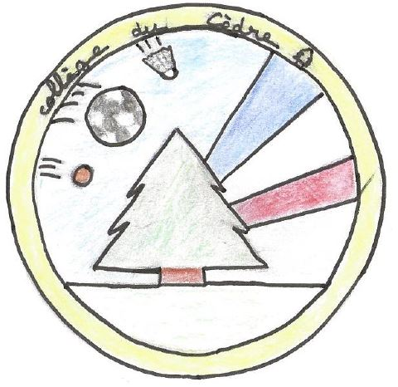
Today, I am going to present the new medal which represents « Le Cèdre » school.
The ping - pong ball represents the extracurricular sports lessons taught at school such as ping-pong, hence the ping-pong ball, indoor football, with the soccer ball, and badminton, hence the shuttlecock. The blue white red flag represents the flag of France. This new medal was created
because « Le Cèdre » school is THE best school in the Yvelines department. It is intended for all the teachers of this secondary school, to thank them for teaching us a lot.
By Jessica 5e3

Slide 13
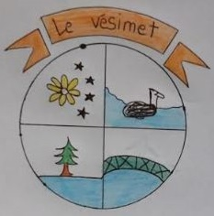
This medal represents the emblems of Le Vésinet .
There is a flower and a tree because there are lots of plants: they represent the greenery; and there is a swan which represents animal life in « Le Vésinet ». There is a lake which represents the freshness of « Le Vésinet ».
We created this medal for the inhabitants of the city : they must wear it on their clothes to show that it comes from Le Vésinet.
By Lina 5e 1

Slide 14
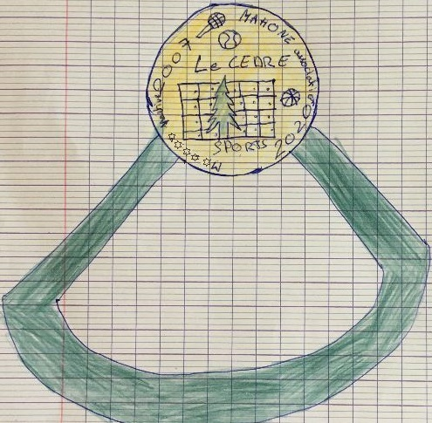
This medal represents « Le Cèdre » school. We created it to reward the winners of he school sports association who win competitions. It will come with a pure green ribbon to represent the cedar tree.
I drew the locker room in the background and on the sides, sports elements such as a basket-ball, a badminton racket and a tennis ball.
I added the year when I was born and the year of creation of this medal. To finish I wrote my name because I am the creator of the medal.
By Mahone 5e3

Slide 15
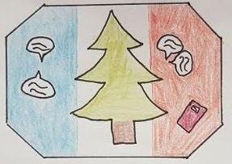
In the middle of this medal, there is a cedar tree. On the bottom right there is a notebook and on both sides there are bubbles which represent pupils who are speaking. I created a new model of medal because the old one was no longer pretty enough. I dedicated it to Charlemagne because he «created » school!
By Mathéo 5e3

Slide 16
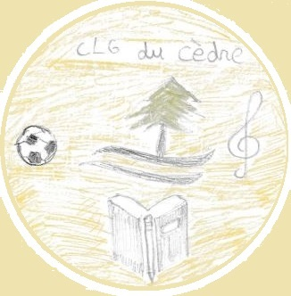
I created this new medal intended for « Le Cèdre » middle-school. I wished to add other symbols which seem important to me in our time. I wanted the logo to be more modern. That is why I added a ball which symbolizes sport. I also put a G clef which represents musical culture and to finish I added a book with a pen which symbolizes school.
By Maxime M. 5e3

Slide 17
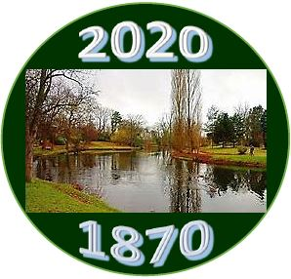
In 2020, a medal for Le vésinet is created for the 150th anniversary of the city. The creator of the medal is Nathan. He won the competition. He is a student in the school Princesse. He is 10 years old.
The medal is round. The design on the first side features an engraving of the famous “Ibis” lake
Of the city. The other side features a coat of arms with a daisy, two golden oak leaves and a golden horn.
By Maxime W. 5e3

Slide 18
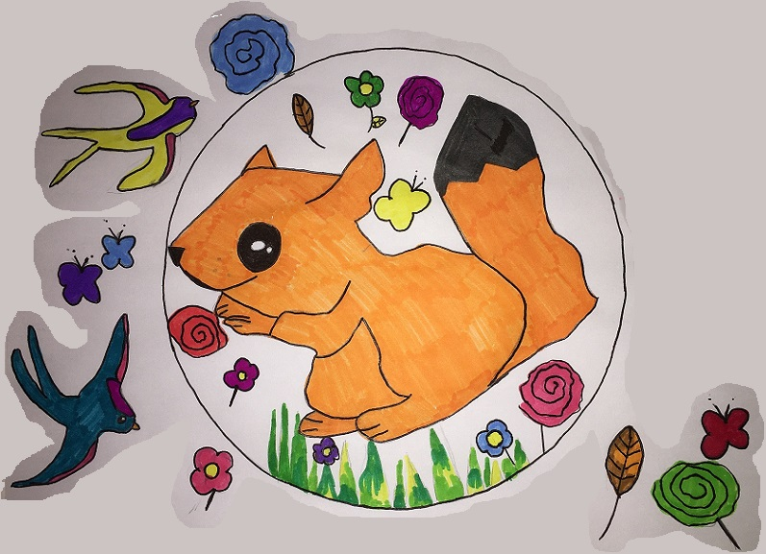
A new medal has been created because we don’t hunt anymore in Le Vésinet.
Now we protect animals instead of killing them.
It was made for all the people who protect animals and plants in our city.
By Mélanie 5e2

Slide 19
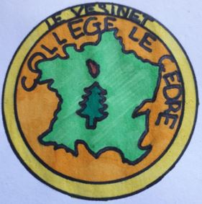
This medal is the symbol of the « Collège Le Cèdre » that I created. In the middle there is France and the Yvelines in the north; there is a cedar, the name of the school and the name of the city.
The department of the Yvelines is the department where the school is located, France the country of this establishment, the Vésinet is the city, the
« Collège le Cèdre » the name of the school and the cedar the emblem. This medal was created to replace the old one and is intended for all students.
By Morgane 5e3

Slide 20
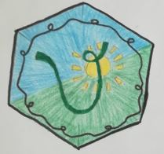
I chose to make this medal for the inhabitants of Le Vésinet because the current emblem of Le Vésinet no longer seems to me to be in true agreement with our times.
I represented this medal like this because that is what the evocation of the city reminds me of.
I drew a large V on a green and blue background because the colours recall the banks of the river Seine and the lace around is to enhance the design.
By Nicole 5e3

Slide 21
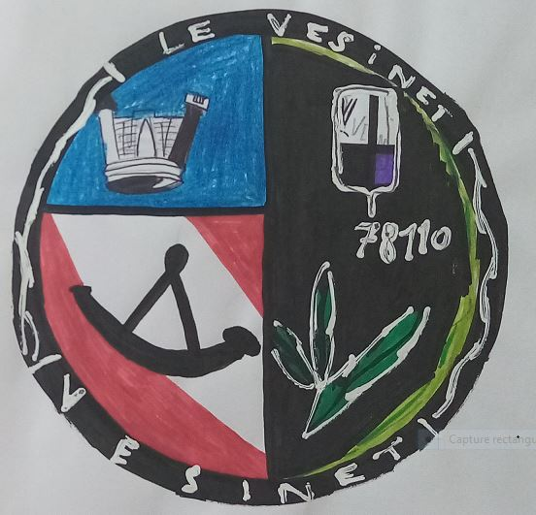
Here is the new medal of « Le Vésinet ». I created it because the actual one was too old. This medal is intended for the people of
« Le Vésinet ».
In this design, I created a castle which represents the castle of the town. There is a hunting horn too because there were hunters a long time ago. There is the leaf of an oak tree because there are lots of trees in the town, expecially oaks.
Paul-Antoine 5e3

Slide 22
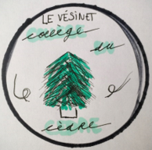
This is the new medal of “le Cèdre” school.
I created this medal because I think it’s a good representation and there is the cedar. It is intended for the school and every student.
In the middle, there is the cedar tree of our school.
Above there is the name of the town and the name of the school.
On the edge, there are decorations.
All this is inside a circle.
By Pauline 5e3

Slide 23
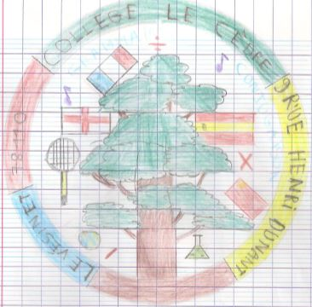
On this medal of « Le Cèdre » school , we can see a cedar, in the centre of the playground and all around pictures like a badminton racket or mathematical signs. But there are also flags, music notes and a flask. This medal represents « Le Cèdre » School by showing the subjects we study there.
This medal was created to reward students who throughout their school years were congratulated during the class term conferences. This medal is dedicated to all the students who have excelled in this school.
By Pierre 5e3

Slide 24
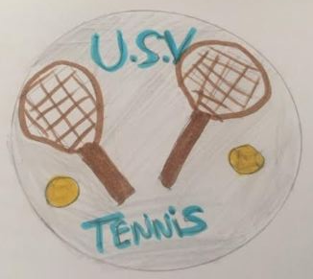
This medal was created to celebrate a new event which takes place in « Le Vésinet »: the 40th anniversary of the tennis tournament of the city.
The mayor will give this medal to the children who win the tournament. The medal is composed of two tennis rackets, two balls and the name of the club.
By Raphaël 5e1

Slide 25
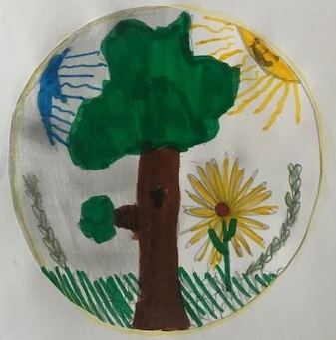
A new medal representing « Le Cèdre » secondary school was created to replace the old one, to give it a good image.
Thus, parents will continue to enrol their children there and students will study with pleasure and interest.
The design of the medal has three emblems to represent the school and its city: a daisy and a garland of oak foliage recalling the emblem of « Le Vésinet » city, and the sun recalling the bust of Louis XIV in the school park.
By Rayan 5e2

Slide 26
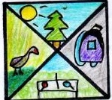
This medal is divided into four parts:
On top, there is a cedar with the sun.
On the left, there is a duck and a lake.
At the bottom there is a ping-pong table
with two rackets.
On the right there is a school bag.
I created this medal because every five years
the medal is renewed. It is intended for students.
By Roxane 5e3

Slide 27
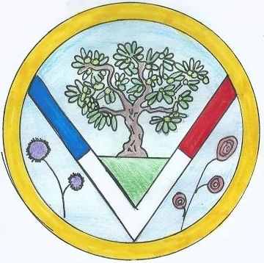
In 2020 a new medal was created to replace the coat of arms of the town.
The new design features different symbols to represent the town:
. The tree symbolizes « Ibis » Park and the highschool, « Le Cèdre ».
. A capital « V » for the first letter of « Vésinet ». The colours of the letter « V » (blue, white, red) represent the flag of France.
. There are also flowers because Le Vésinet is a flowery town.
By Sarah 5e2

Slide 28
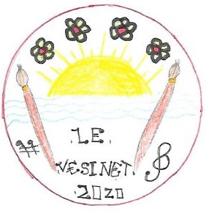
In 2020, Le Vésinet decided to change its coat of arms in order to replace it with a new medal.
This event is related to the election of a new mayor who wants to mark his territory.
This new medal is intended for all Vésigondins (the inhabitants of Le Vésinet) who could give their opinion.
We can see different elements: a lake which is typical of Le vésinet, four flowers because the city has won the national cities competition of flowers, paintbrushes because many painters as De Vlaminck and Utrillo lived in the city.
By Yannis 5e2

Slide 29
THE END
Thank you for watching. We hope you enjoyed your visit.
Thank you to our young artists for sharing their talent with us.
5e1 5e2 5e3

